Slide 1
AI FASHION DESIGN GENERATOR
CAPSTONE PROJECT
Presented By
Student Name: Piyush Parmanand Ramteke
College Name: G H Raisoni University, Amravati
Department: BCA
AICTE ID: STU6a0db90a60d191779284234

Slide 2
OUTLINE
01Introduction / Background
02Problem Statement (Excludes solution)
03System Architecture / Workflow
04Key Features / Modules
05Proposed System / Solution
06System Development (Technology Used)
07Algorithm & Deployment
08Result
09Conclusion
10Future Scope
11Results / Screenshots
12References

Slide 3
INTRODUCTION & BACKGROUND
brush
01 / INSIGHT
Manual Ideation
Creating and iterating on fashion concepts manually requires significant time and expertise.
handyman
02 / BARRIER
Specialist Tools
Professional design software can create technical and accessibility barriers for non-expert users.
link_off
03 / INEFFICIENCY
Fragmented Flow
Design generation, product discovery, and virtual try-on are commonly handled as separate processes.
auto_awesome
04 / SOLUTION
Opportunity
Generative AI can combine these stages into one unified fashion workflow.

Slide 4
PROBLEM STATEMENT
Traditional Workflow
1. Idea
➔
2. Manual Design
➔
3. Visualization
➔
4. Product Search
➔
5. Try-On
Traditional Barriers
• Lack of Technical Skills: Many students want to explore fashion design but lack the necessary artistic or technical training [cite: 4].
• High Entry Barriers: Traditional prototyping and design tools are expensive, slow, and resource-intensive [cite: 4].
The AI Opportunity
• Text-to-Design: Instantly synthesize unique, customizable clothing designs directly from simple text prompts [cite: 4].
• Intelligent Matching: Suggest similar, highly affordable products online to connect digital designs with physical retail [cite: 4].
• Enhanced Accessibility: Empowers aspiring creators by making fashion design deeply interactive, accessible, and fun [cite: 4].

Slide 5


SYSTEM ARCHITECTURE
USER / BROWSER
API Routes
/api/design Cloudflare Workers AI
/api/products/search RapidAPI H&M Store
/api/try-on Hugging Face IDM-VTON
/api/health Service health check
VERCEL PLATFORM
• React + Vite Frontend
HTTP / API Calls (Serverless)
• Python Serverless APIs
Key Architecture Benefit
Single Vercel deployment handles both the React frontend and Python serverless API layer, while external AI services are securely accessed through server-side APIs.
Cloudflare AI
FLUX / SDXL
Design Gen.
RapidAPI H&M
Products API
Recommendation
Hugging Face
IDM-VTON
Virtual Try-On
Secrets remain server-side • Serverless • Scalable • No separate backend deployment

Slide 6
KEY FEATURES / MODULES
brush
AI Fashion Studio
Create fashion designs from natural-language prompts.
psychology
Fashion Spec
Extract structured attributes like fabric, fit, and budget.
image
Image Generation
Generate fashion concepts using multiple AI models.
local_mall
Product Match
Find matching real products through the H&M API.
checkroom
Virtual Try-On
Generate interactive AI try-on results using IDM-VTON.
folder
Collections
Save and manage your generated fashion designs.
assignment
Tech Pack
Generate structured technical fashion specifications.
download
Utilities
Download designs and copy specifications instantly.

Slide 7
PROPOSED SOLUTION
Unified AI Fashion Workflow
01
User Fashion Idea
Initial creative concept or design inspiration.
02
Specification Extraction
Gemini extracts key features and attributes.
03
Image Generation
Generates high-fidelity fashion visuals.
04
Product Match
Recommends real, matching inventory.
05
AI Virtual Try-On
Allows users to try garments virtually.
06
Tech Pack & Co.
Exports final collections & tech sheets.
➔
➔
➔
➔
➔
auto_awesomeA unified end-to-end fashion ideation and visualization platform powered by Generative AI.

Slide 8
System Development — Technology Used
code
Frontend
React 19
Vite 8
Tailwind CSS 4
Lucide React
dns
Backend / API
Python
Vercel Serverless
Pydantic
HTTPX
psychology
Artificial Intelligence
Gemini 2.5 Flash
Cloudflare AI
IDM-VTON
cloud
External Services
Hugging Face
H&M Store API
Vercel
Note: Your technology choices should match the latest repository rather than the older FastAPI architecture shown in the sample.

Slide 9
ALGORITHM & DEPLOYMENT
A. Recommendation Algorithm
Metadata Matching Weights:
Category Match40%
Color Match25%
Budget Fit20%
Style / Brand15%
Scoring Formula:
Score = Cat + Color + Budget + Style
* Structured metadata matching only; does not use vector embeddings for this ranking.
B. Deployment & Architecture
CI/CD & Hosting Pipeline:
GitHub ➔ Vercel ➔ React + Python APIs ➔ External APIs
Production API Routes:
GET /api/design
POST /api/products/search
POST /api/try-on
GET /api/health

Slide 10
RESULT
Project Outcomes
✓ AI-based fashion concept generation
✓ Structured fashion specification extraction
✓ Multiple AI image generation models
✓ Real H&M product recommendations
✓ IDM-VTON virtual try-on integration
✓ Before / After try-on experience
✓ Collections and Tech Pack functionality
✓ Download and copy utilities
✓ Serverless Vercel architecture
✓ Security and input validation
stars
Key Result
Successfully integrated multiple AI and external services into a unified fashion design workflow.

Slide 11

CONCLUSION
OVERVIEW
Unified Platform
The AI Fashion Design Generator demonstrates how Generative AI, product APIs and computer-vision-based virtual try-on can be combined into a unified fashion platform.
KEY IMPACT
The project reduces fragmentation in the fashion ideation workflow by bringing design generation, product discovery and virtual try-on into one application.
ARCHITECTURE
Connected Workflow
The system seamlessly connects each stage of fashion creation:
01IDEATION
02GENERATION
03RECOMMENDATION
04TRY-ON

Slide 12
FUTURE SCOPE
AI & Virtual Try-On
■Improved garment extraction
■Better garment preprocessing
■Higher-quality virtual try-on
■More advanced fashion generation
Recommendation
■More fashion marketplaces
■Personalized recommendations
■Advanced product similarity
Platform
■User authentication
■Cloud-based collections
■Analytics dashboard
■Mobile application
Please Note: These items represent future roadmap scope and are not currently completed features.

Slide 13
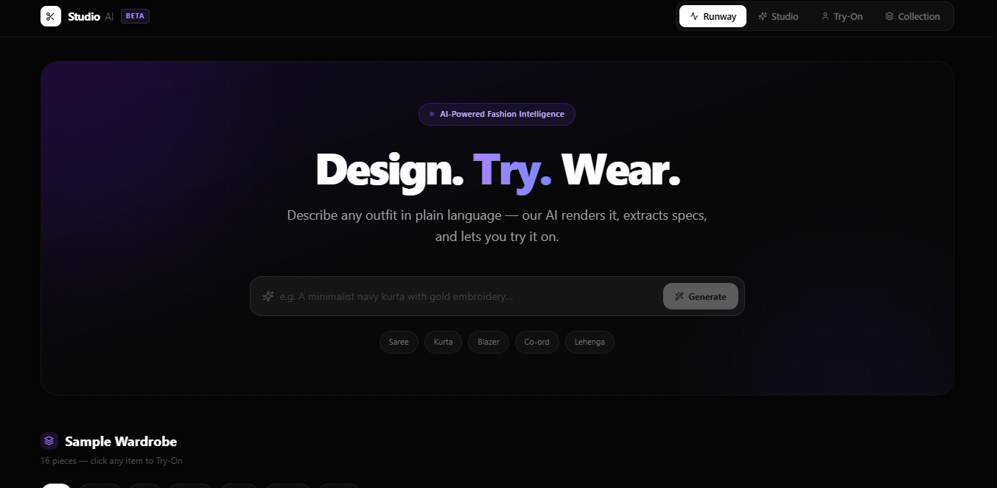

RESULTS & SCREENSHOTS
System Performance: Real-time processing and pipeline execution successfully validated.

Slide 14
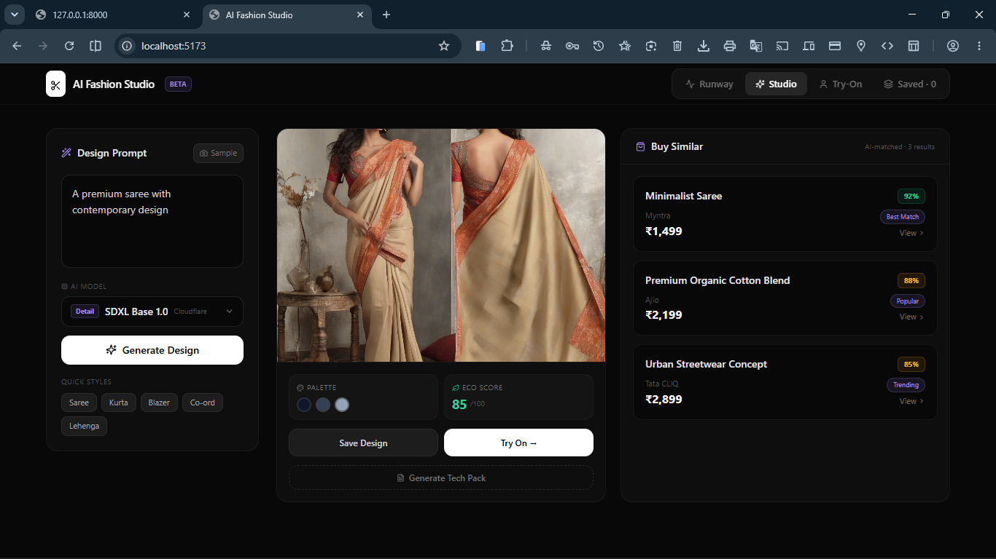

Slide 15
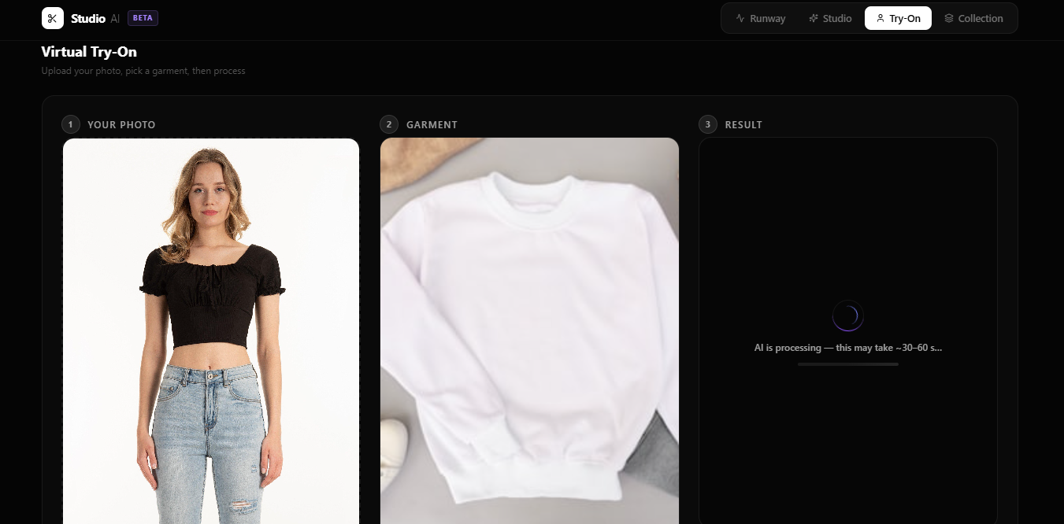

Slide 16
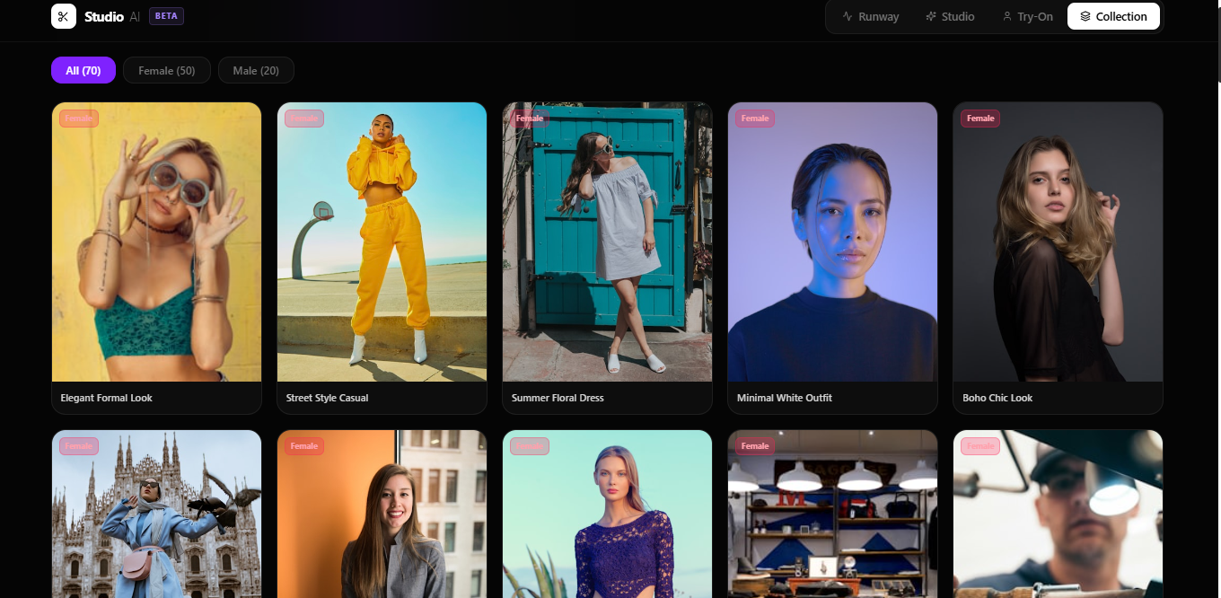

Slide 17
REFERENCES
Project & Code
AI Fashion Design Generator
IBM Internship 2026
■ GitHub Repository:
AI-Fashion-Design-Generator-IBM-INTERSHIP-2026
Third-Party Model
■ IDM-VTON
License: CC BY-NC-SA 4.0
Technologies & APIs
■ Google Gemini
■ Cloudflare Workers AI
■ RapidAPI H&M Store API
■ Hugging Face
■ IDM-VTON
■ Vercel
Documentation
■ React
■ Vite
■ Tailwind CSS
■ FastAPI & Python
■ Vercel Platform Docs
References & Standards: Keep this project structure clean, modular, and fully documented.

Slide 18
DEPLOYMENT & REPOSITORY
🔗 Live Demo
Deployment Platform:
Vercel Platform
Verified URL:
https://ai-fashion-design-generator-ibm-int.vercel.app/
💻 GitHub Repository
Source Code & Documentation:
github.com/Piyu242005/AI-Fashion-Design-Generator-IBM-INTERSHIP-2026
📚 Technologies
■ React
■ Vite
■ Python
■ Vercel
References & Standards: Keep this project structure clean, modular, and fully documented.

Slide 19
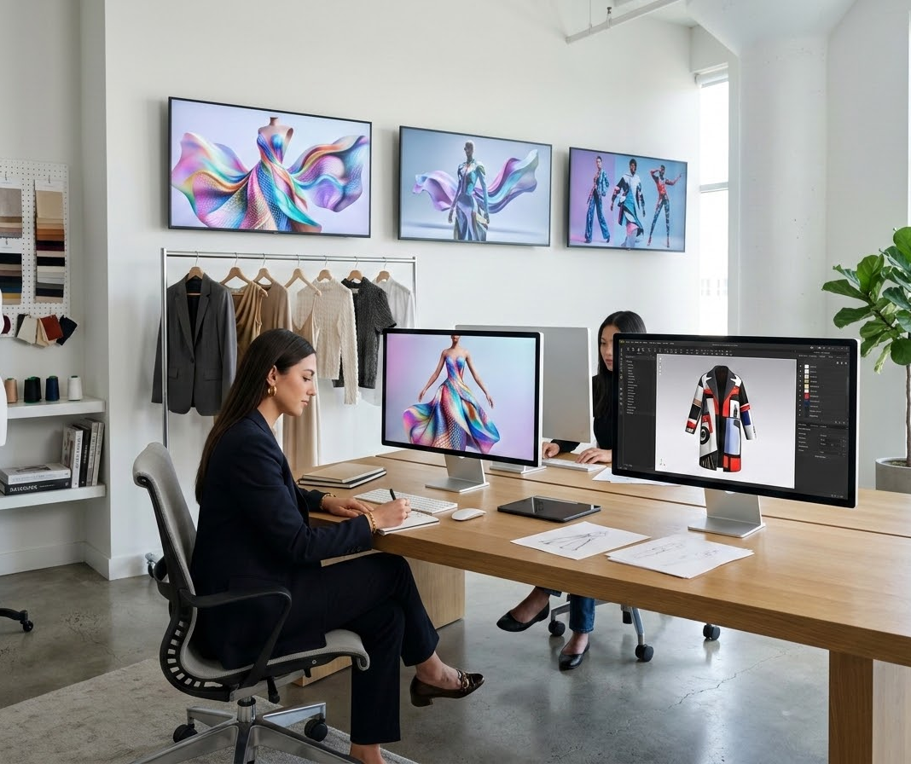
THANK YOU
"From idea to design to try-on — powered by AI."
Piyush Ramteke
IBM Internship 2026
AI Fashion Design Generator

